Slide 1
Projectile Motion BASICS
In this PPT you will find:
A Do-NOW that will gauge students prior knowledge about one-dimensional and two dimensional motion
Lesson Objectives
A walkthrough of Projectile Motion Characteristics
A Guided Practice Activity that delivers the content in a Q&A format
An Exit Ticket that is designed to assess their grasp on the learning targets presented in the PPT

Slide 2
PHYSICS DO-NOW
1) What does it mean for something to be VERTICAL?
2) What does it mean to be horizontal?
3) Is the cannon shooting HORIZONTALLY or VERTICALLY?
3) Is your notebook organized? It should be, because when I check today’s Do-Now I’m checking your notebook

Slide 3
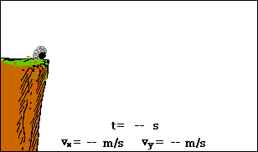
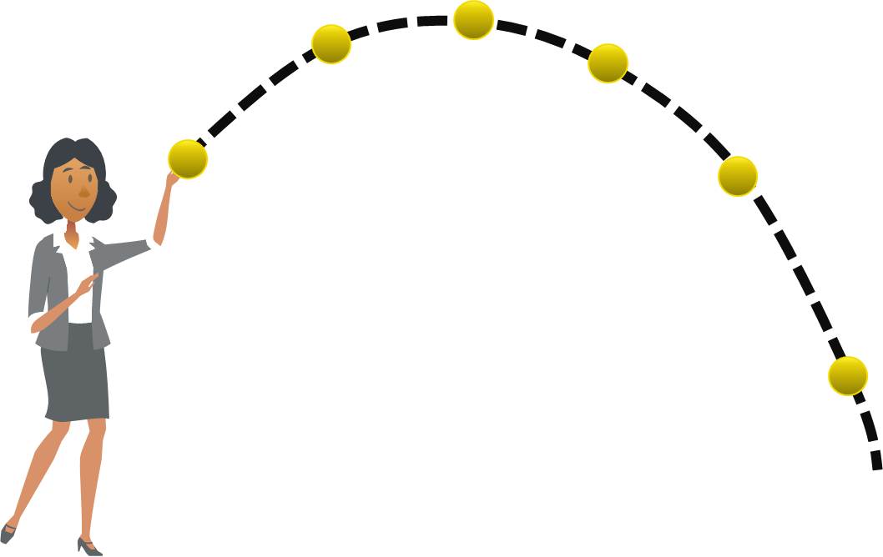
WHAT YOU SHOULD LEARN TODAY!
Differentiate between 1 & 2 Dimensional Motion
Explain the characteristics and conditions of Projectile Motion

Slide 4
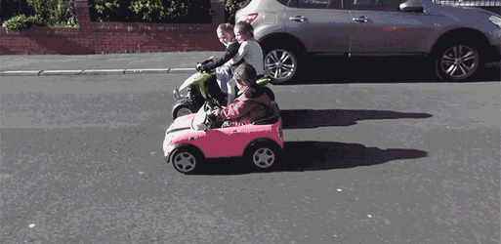
1-DIMENSIONAL MOTION

Slide 5
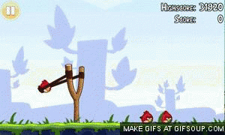
What game is this?
ANGRY BIRDS

Slide 6
Is this bird moving up or forward?
BOTH!

Slide 7
What is Projectile Motion?
Objects that are thrown or launched in the air and are subject to gravity are called projectiles.
Projectile Motion is the curved path that an object follows when thrown, launched, or otherwise projected near the surface of Earth
The path of a projectile curve is called a parabola

Slide 8
WHAT would happen if a cannonball was shot out of this cannon with NO gravity present?
It will float
Move in a straight line
Fall straight down

Slide 9
WHY would this happen? (Think about forces that would be acting on the cannon)
Harry Potter used Wingardium Leviosa
The devil is loose
No gravity present to pull it downward
Energy from cannon was too strong

Slide 10
If there are no forces pushing down on it, is there a force pushing it forward DURING its flight?
Yes, you just can’t see it
No
The force from the cannon is still pushing it

Slide 11
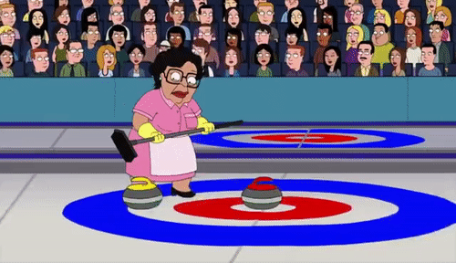
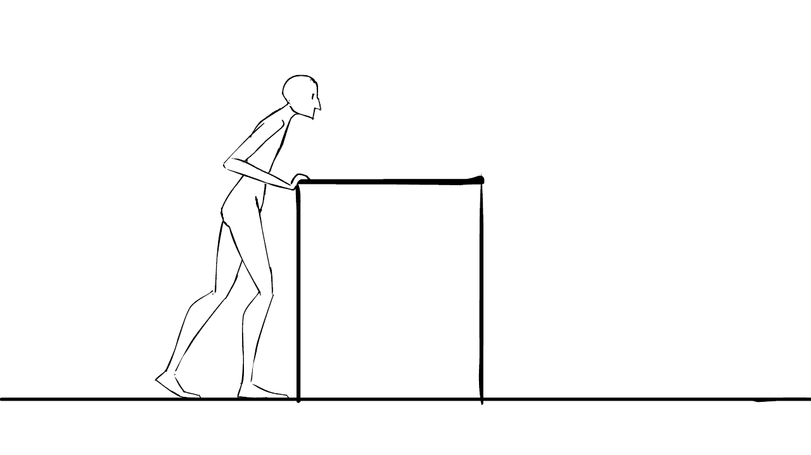

Slide 12
If there are NO forces pushing it forward during its flight, what can we assume about its velocity
It’s velocity is not changing (constant), since there is no force to change it
It’s velocity is increasing, because no forces acting on it allows it to behave how it wants
It’s velocity is decreasing because with no force it will slow down

Slide 13
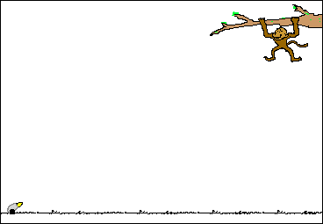
GRAVITY-FREE ENVIRONMENT
WHAT would happen to the path of this banana once gravity is turned on?
The banana will drop straight down
The banana will follow a curved path
The banana will go straight up

Slide 14
What causes the curved path in projectile motion???????
GRAVITY!!

Slide 15
Now that gravity is on…is there a force pushing the banana forward DURING its flight?
No there is still no force pushing it forward
Yes, gravity is now pushing it forward

Slide 16
Soo, is velocity changing in the X-direction?
A. YES! Velocity can increase with no forces acting on it
B. NO! The Horizontal velocity is constant
Is velocity changing in the Y-direction?

Slide 17
Soo, is velocity changing in the Y-direction?
A. YES! Because Gravity IS pulling it downward
B. NO! If the Horizontal velocity is constant, then Vertical velocity is constant
Is velocity changing in the Y-direction?

Slide 18
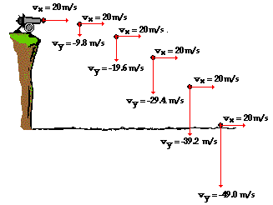
What do you notice about Vx in this picture? +pp
Why is this happening?

Slide 19
What do you notice about Vy in this picture? +pp
Why is this happening?

Slide 20
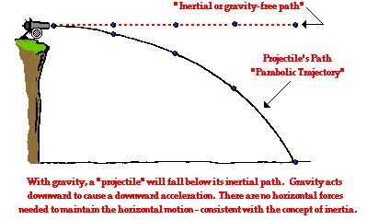
Projectile Motion is TWO dimensional!
Projectiles are traveling in two dimensions, therefore have velocity on the x and y axis at.
the same time
Its horizontal velocity (V_{x}) is constant because there are no forces acting on it in the x-direction.
Its vertical velocity (V_{y}) is changing due to the force of gravity. It changes at a rate of -9.81m/s².
* All aforementioned notes are ignoring air resistance

Slide 21
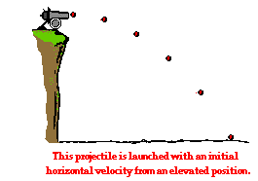
Physics Exit Ticket_
V_{x}= 4m/s
A
V_{x}= ???
What mathematical curve does a projectile’s trajectory follow?
What causes the parabolic shape of projectile’s trajectory?
What do we know about the horizontal velocity of this cannon and why?
If the initial velocity on the X axis is 4m/s, what is the velocity on the x axis at points A & B?
V_{x}= ???
B

