Slide 1

Intro to Atomic Structure
In this PPT you will find:
  A Do-NOW that will review what students learned from our introductory ADI and gauge their prior knowledge about atomic structure
  The solution to this Do-Now organized as a full group share out
  Lesson Objectives
  A walkthrough of Basic Atomic Structure of Neutral Atoms and Reading the Periodic Table
  An Exit Ticket that is designed to assess their grasp on the learning targets presented in the PPT

Slide 2
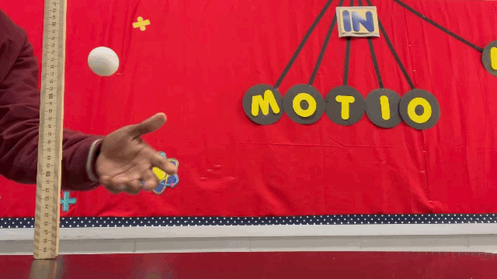
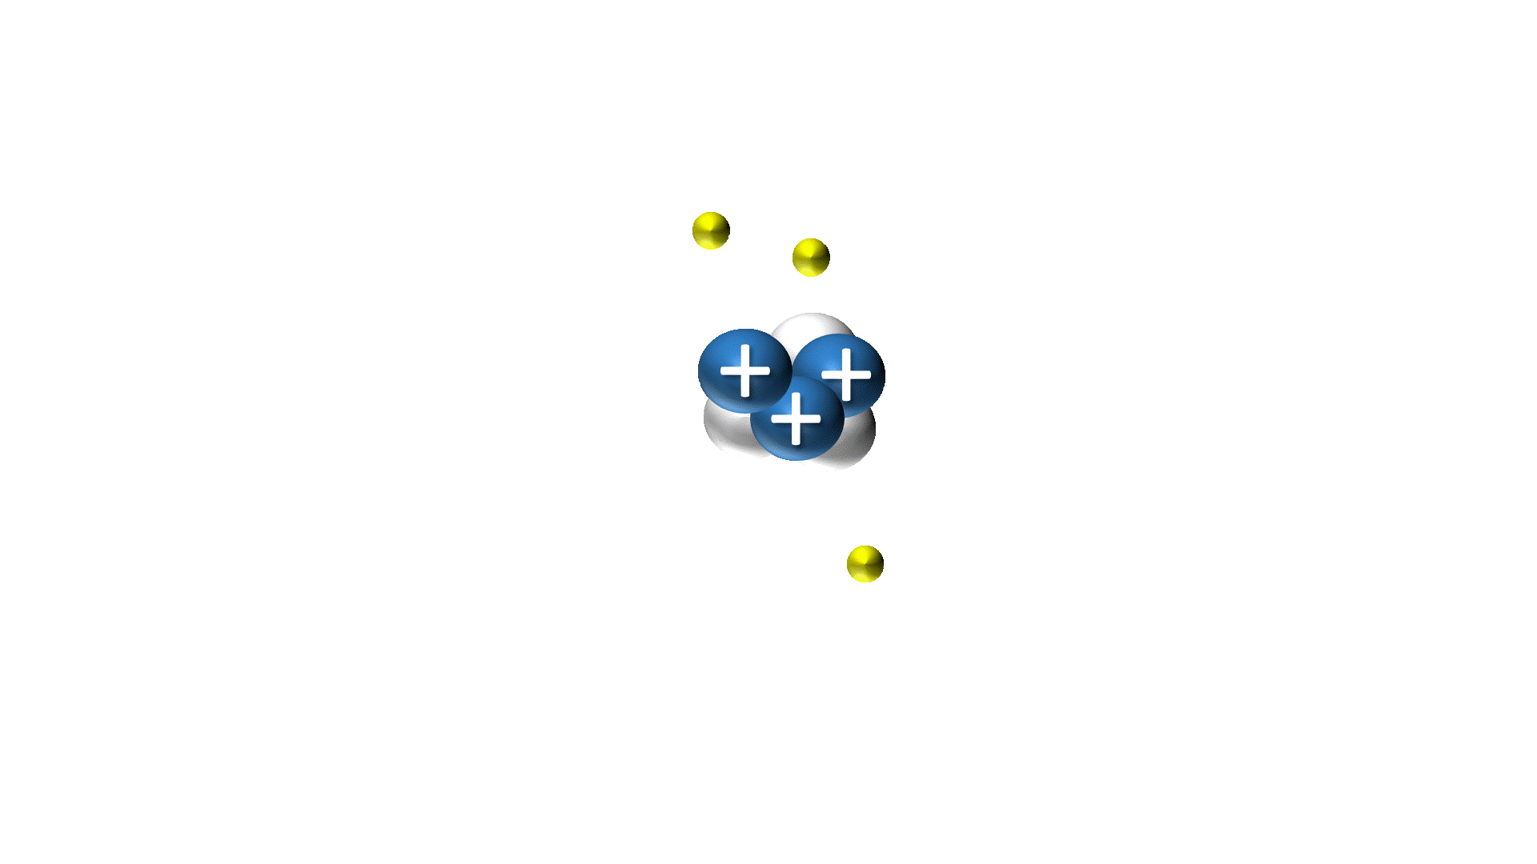
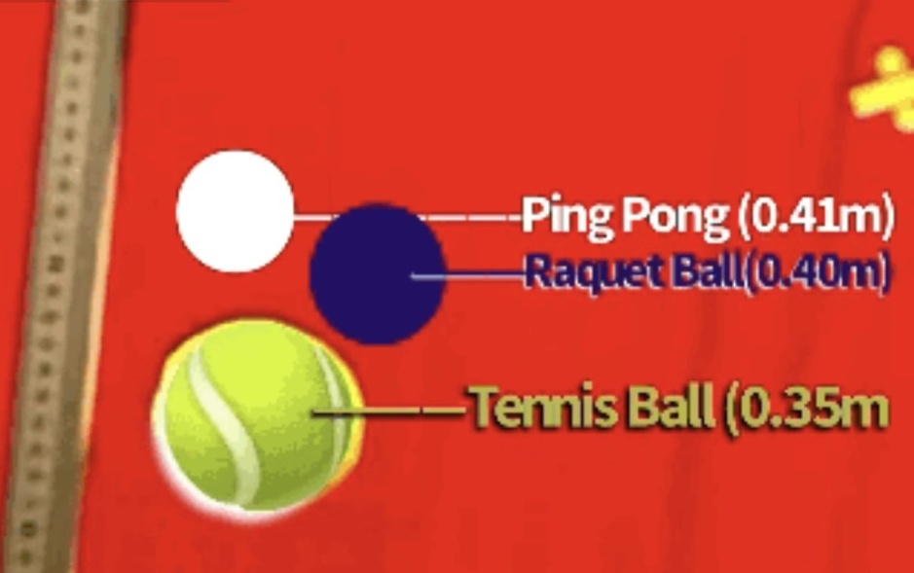
DO-NOW
MOST data from our first ADI showed that the ping pong and rubber ball bounced the highest. Why do YOU think that is?
Most found that the carpet produced the LOWEST bounce height. Why do YOU think that is?
How many PROTONS do you see in the atom to the right?
How do you know that they are protons?

Slide 3
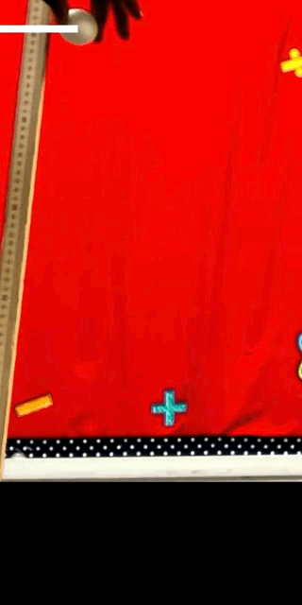
LET’S GO OVER IT
MOST data from our first ADI showed that the ping pong and rubber ball bounced the highest. Why do YOU think that is?

Slide 4
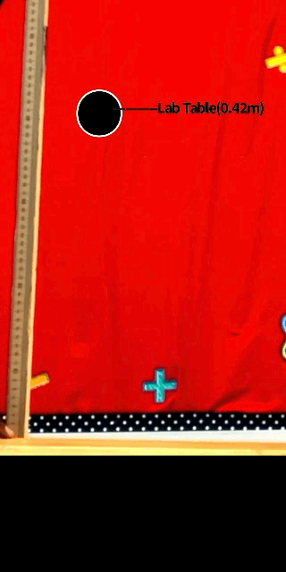
LET’S GO OVER IT
2) Most found that the carpet produced the LOWEST bounce height. Why do YOU think that is?

Slide 5
LET’S GO OVER IT
3) How many PROTONS do you see in the atom to the right?
4) How do you know that they are protons?

Slide 6
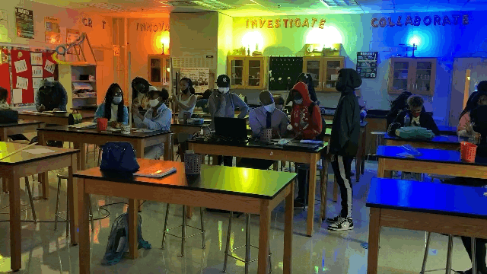

  WHAT HAPPENED WEEK 2?
MONDAY 8/16 (Graphs & Justifying Claims)
The purpose of graphs in data collection
How to make a graph and analyze trends of data
How to justify a claim using evidence
WEDNESDAY 8/18 (Communicating Results)
The purpose of communicating results after scientific inquiry
How to make a graph and analyze trends of data
How to justify a claim using evidence
FRIDAY 8/18 (ADI Presentations)
How to provide and receive feedback to peers about results

Slide 7
UNPACKING THE STANDARD
SPS1. Obtain, evaluate, and communicate information from the Periodic Table to explain the relative properties of elements based on patterns of atomic structure.
a. Develop and use models to compare and contrast the structure of atoms, ions and isotopes.

Slide 8
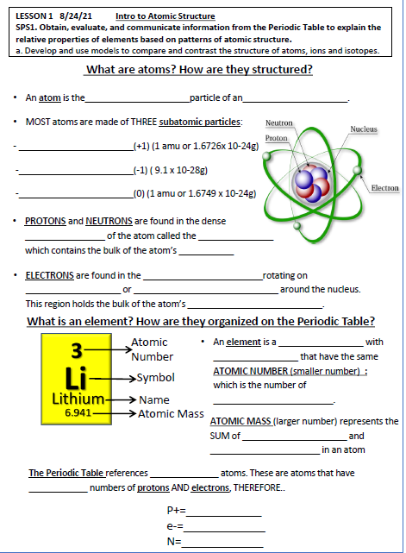

BEFORE WE START YOU SHOULD:
Make sure you have your notes
Put your phone up
PAY ATTENTION
PARTICIPATE!!!
Understand this is our first lesson!

Slide 9

WHEN YOU SEE THIS:
There’s something you should be writing!

Slide 10
WHAT YOU WILL BE ABLE To do before you leave!!!!
Explain the importance of atomic structure as a system
Locate protons, neutrons in a stable and neutral atom
Differentiate between the masses of protons, neutrons, and electrons
Differentiate between atomic mass and atomic number
Identify number of protons, neutrons, and electrons using atomic number and atomic mass

Slide 11

Can this be broken down into smaller parts?

Slide 12
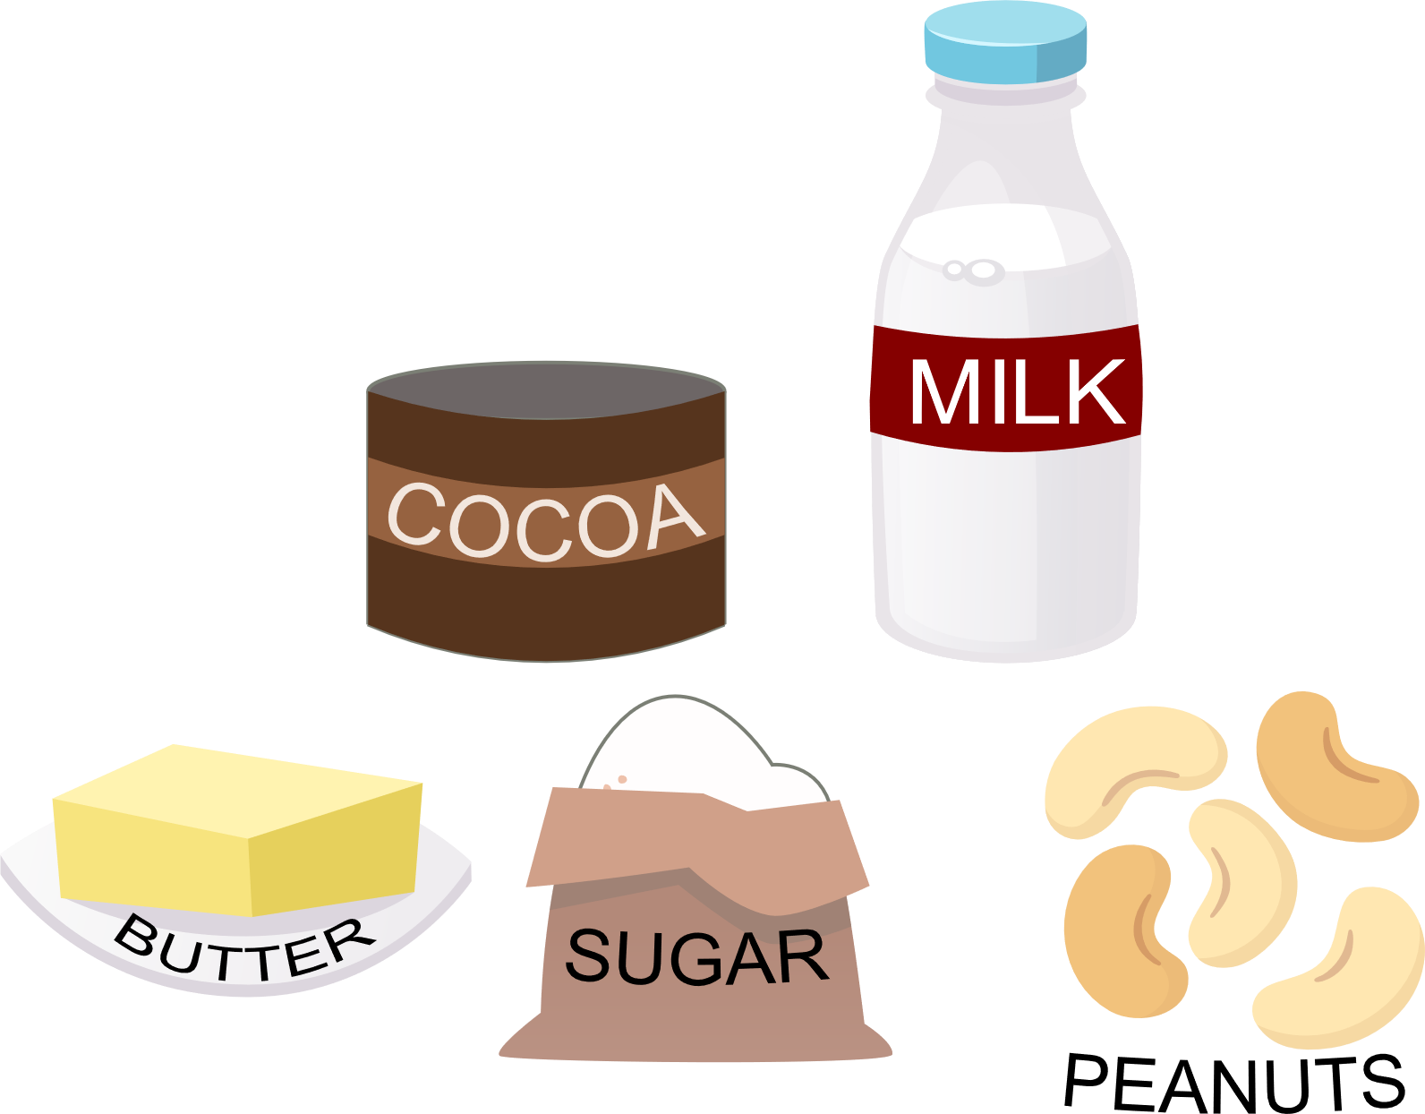
YES!

Slide 13

Can this be broken down into smaller parts?

Slide 14


YES!

Slide 15
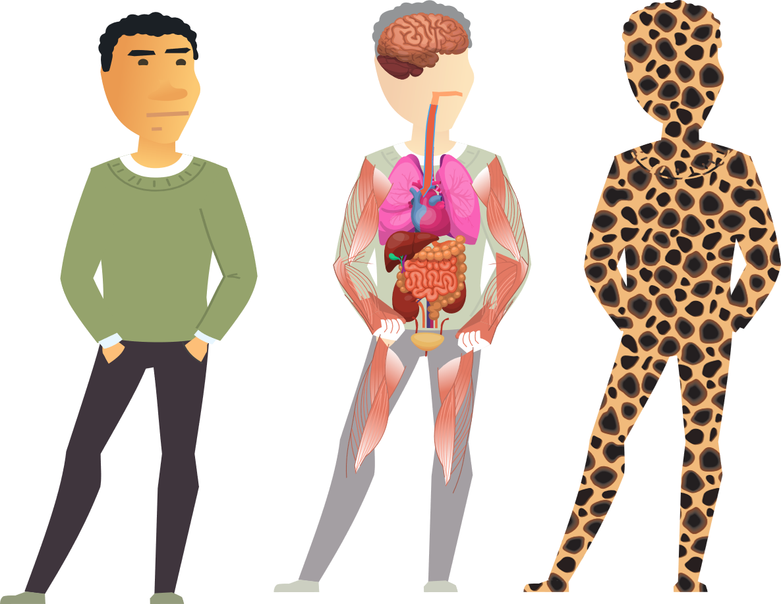
Science revolves heavily around the study of SYSTEMS
Your body is made out of….?
CELLS!
a group of related elements that function together
ORGANS!
...which are made out of…?

Slide 16

NO!
MATTER
Is this phone made of cells????
What is it made out of?

Slide 17
Everything in this room that you can see and cannot see is made of MATTER

Slide 18

…what is MATTER?
Anything that has MASS and takes up space!!

Slide 19

ATOMS
WHERE IS THIS MASS COMING FROM?!?!

Slide 20

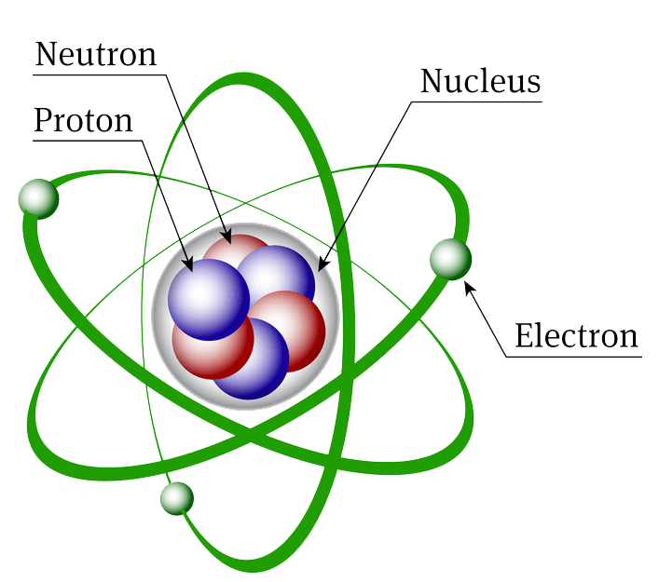


What is an atom?
An ATOM is the fundamental particle of matter.

Slide 21
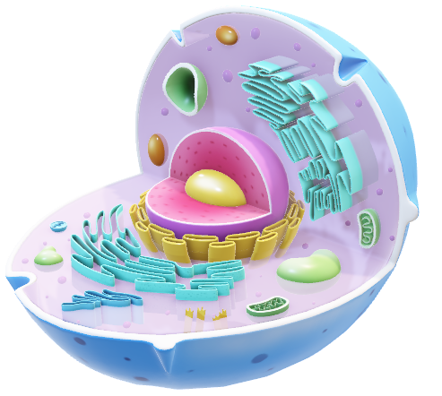
Cells are the fundamental unit of LIVING things

Slide 22
Atoms are the fundamental unit of ALL THINGS

Slide 23
The behavior of atoms control all things from trivial to severe

Slide 24


X
Can wood conduct electricity?
NO, but metals can. WHY?

Slide 25
X
The STRUCTURE OF THEIR ATOMS

Slide 26
LET’S GO OVER IT
MOST data from our first ADI showed that the ping pong and rubber ball bounced the highest. Why do YOU think that is?
The STRUCTURE OF THE ATOMS in plastic and rubber

Slide 27
LET’S GO OVER IT
2) Most found that the carpet produced the LOWEST bounce height. Why do YOU think that is?
The STRUCTURE OF THE ATOMS in CARPET

Slide 28
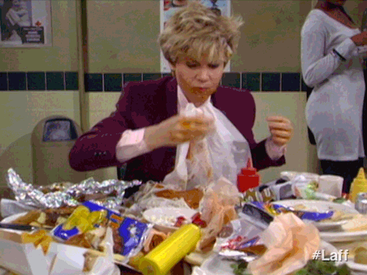
You need the ATOMS in the food!

Slide 29

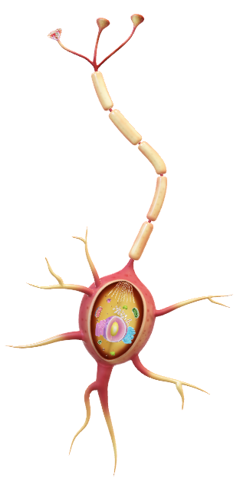
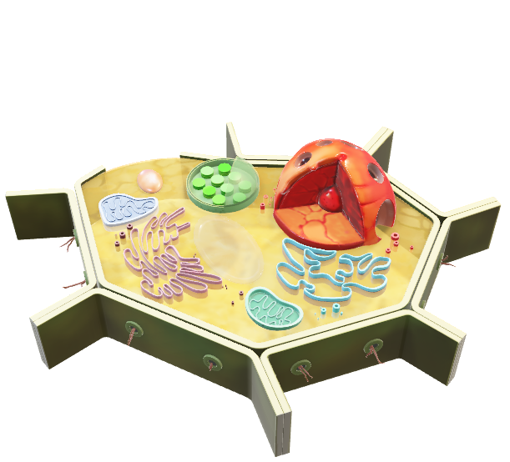
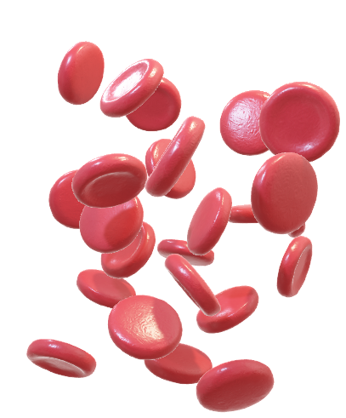
Are all cells the same?!

Slide 30



What makes them different?

Slide 31
Their STRUCTURE controls their FUNCTION!

Slide 32
+
+
+
Are all atoms the same?

Slide 33

+
+
+
+
+
NO! What makes them different?

Slide 34
+
+
+
+
+
THEIR STRUCTURES!!!!

Slide 35

MOST atoms are made of THREE subatomic particles:
PROTONS (+)
ELECTRONS (-)
What do you notice that’s different about them?!
NEUTRONS (0)

Slide 36
MOST atoms are made of THREE subatomic particles:
PROTONS (+)
ELECTRONS (-)
Their CHARGES, MASSES, and LOCATION!
NEUTRONS (0)

Slide 37
MOST atoms are made of THREE subatomic particles:
PROTONS (+1)
ELECTRONS (-1)
Their CHARGES, MASSES, and LOCATION!
NEUTRONS (0)

Slide 38
THEIR CHARGES!
POSITIVE
PROTONS (+1)
NEGATIVE
ELECTRONS (-1)
NEUTRAL
NEUTRONS (0)

Slide 39
THEIR MASSES
-
PROTONS (+)
ELECTRONS (-)
NEUTRONS (0)
Rank them from smallest to largest!

Slide 40
PROTONS (+)
ELECTRONS (-)
NEUTRONS (0)
Rank them from smallest to largest!

Slide 41
Mass is NEGLIGIBLE
ELECTRONS (-)
PROTONS (+)
NEUTRONS (0)
( 9.1 x 10⁻²⁸g)
1 amu
or 1.6726x 10⁻²⁴g
1 amu
or 1.6749 x 10⁻²⁴g

Slide 42
Protons and Neutrons are found in the dense CENTER of an atom in the NUCLEUS which contains the bulk of the atom’s mass

Slide 43
Electrons are found in the Electron cloud rotating on shells or orbitals around the nucleus.
This region holds the bulk of the atom’s volume

Slide 44
+
+
+
+
+
+
+
+
+
Are these atoms the same?
WHAT’S DIFFERENT?!

Slide 45
+
+
+
+
+
+
+
+
+
Atoms can differ in number of neutrons and electrons

Slide 46
+
+
+
+
+
+
+
+
+
Atoms can differ in number of neutrons and electrons
But if they have the same number of PROTONS…they are atoms of the same ELEMENT

Slide 47
Which is the number of…
PROTONS
+
+
+
+
+
+
+
+
+
An element is a substance with atoms that have the same ATOMIC NUMBER.

Slide 48

NO!
+
+
+
+
+
SAME ELEMENT?

Slide 49
YES!
SAME ELEMENT?

Slide 50
YES!
SAME ELEMENT?

Slide 51
NO!
LITHIUM
BERYLLIUM
SAME ELEMENT?

Slide 52
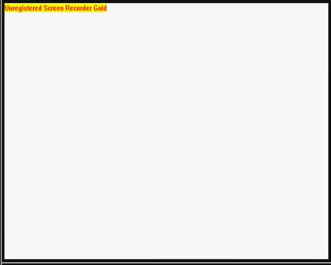

Slide 53
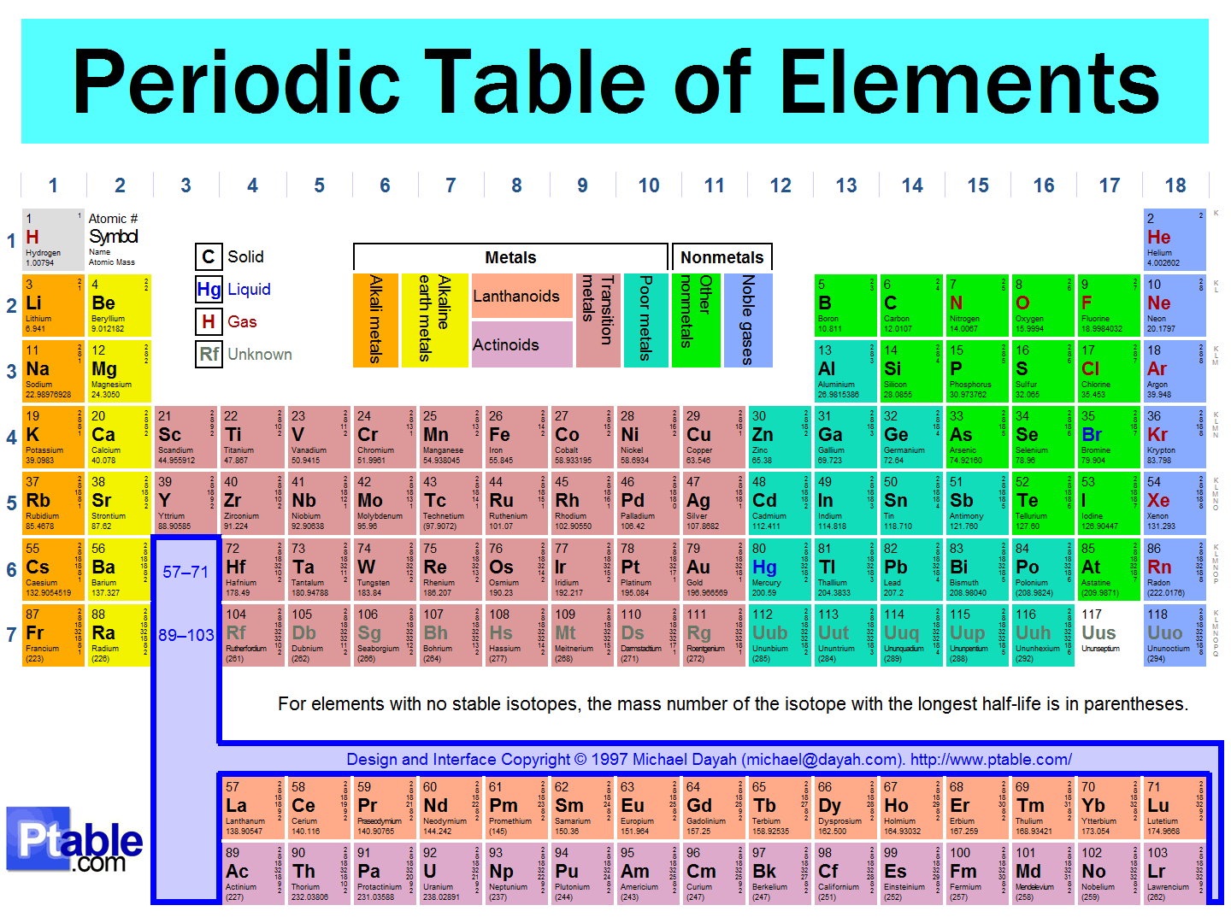
KEEP UP WITH YOURS!
-LATER…fold it and tape into the BACK COVER of your notebook

Slide 54
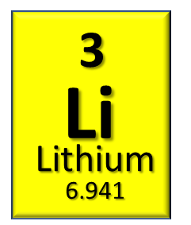
Atomic Mass (larger number) represents the SUM of protons and neutrons
Atomic Number (smaller number) represents the number of protons in an atom
SYMBOL & NAME
SUM of PROTONS and NEUTRONS
What does that mean????
# OF PROTONS
+
# OF NEUTRONS

Slide 55
YES!
SAME ELEMENT?
HELIUM

Slide 56


The periodic table references neutral atoms, …
YOU are who you hang around!!!!

Slide 57

The periodic table references neutral atoms, …
These are atoms that have EQUAL numbers of protons and electrons

Slide 58
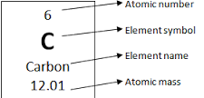
THEREFORE…
P+ = Atomic Number
e- = Atomic Number
N= Atomic Mass - Atomic Number
(ROUND FIRST!!)

Slide 59
The # of Neutrons is NOT equal to the atomic mass!
COMMON MISCONCEPTION

Slide 60
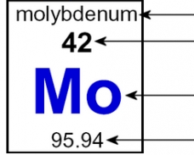
GUIDED PRACTICE!
p+ =
e-=
N=

Slide 61
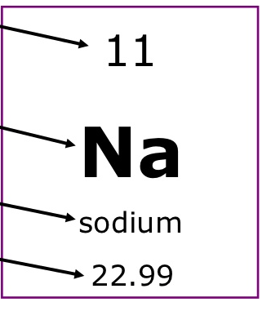
PRACTICE!
List the atomic structure of Sodium
p+ =
e-=
N=

Slide 62
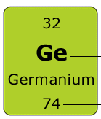
GUIDED PRACTICE
p+ =
e-=
N=

Slide 63
WHITEBOARD!! Hold it up when I say TIME
2
He
Helium
4.003
p+ =
e-=
N=
2
2
2

Slide 64
WHITEBOARD!! Hold it up when I say TIME
List the atomic structure of…
BERYLLIUM
p+ = 4
e-= 4
N= 5

Slide 65
WHITEBOARD!! Hold it up when I say TIME
List the atomic structure of…
COPPER
p+ = 29
e-= 29
N= 35

Slide 66
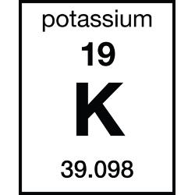
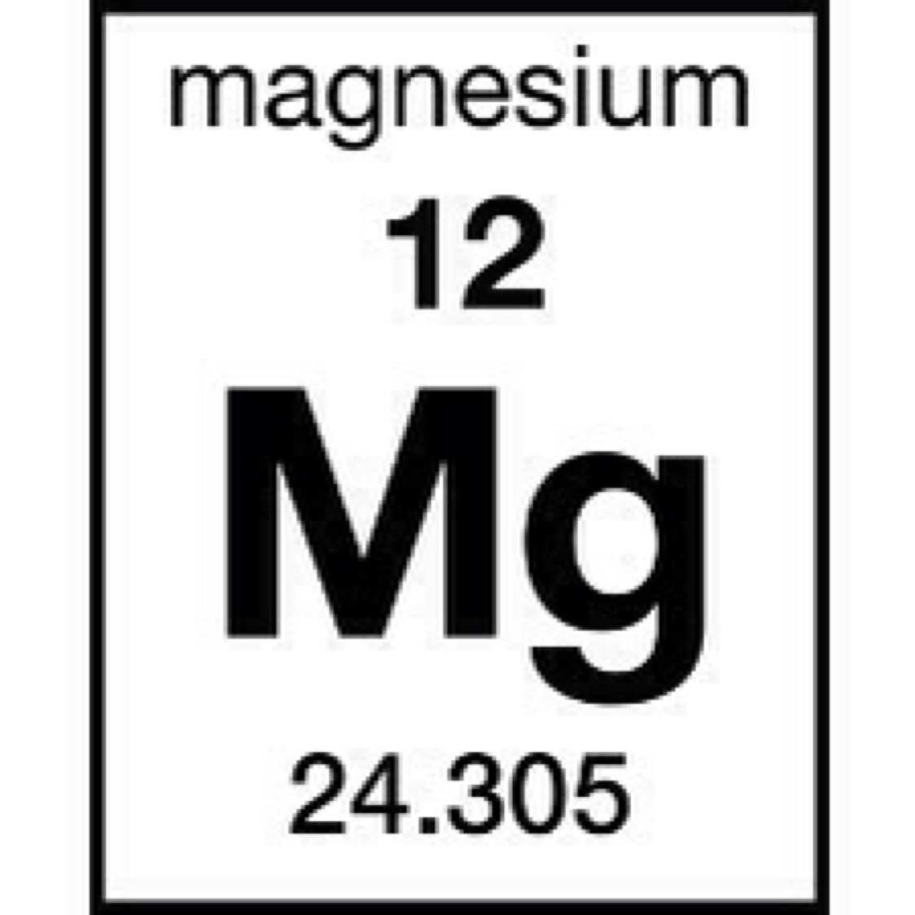
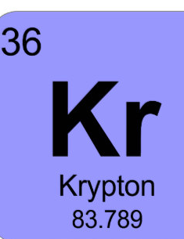
Exit Ticket
True or False, if false explain why. Protons and electrons are found in the nucleus of an atom.
Which of the three subatomic particles has the smallest mass?
How many protons are in an atom of oxygen?
How many Electrons are in Oxygen?
How many Neutrons are in Oxygen?
List the atomic structure of Boron.
7) 8) 9) 10)
7
N
Nitrogen
14.01

