Slide 1
Kinematic Equations
In this PPT you will find:
A Do-NOW that will review what students learned from our PPT on Motion Graphs
The solution to this Do-Now organized as a full group share out
Learning Objectives
A walkthrough of solving ONE Dimensional Kinematic Equations
A Guided Practice Activity that practices solving 1D Kinematic Equations
An Exit Ticket that is designed to assess their grasp on the learning targets presented in the PPT

Slide 2
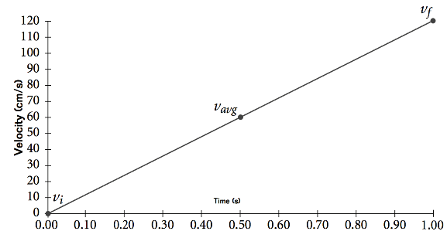
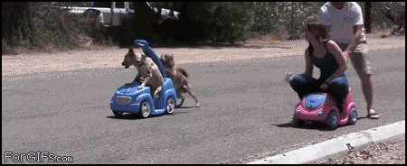
PHYSICS DO-NOW
t_{f} - t_{i}
Velocity (m/s)
What is this object’s acceleration from 0.1 s to 0.4 s?
What is this object’s acceleration from 0.4s to 0.5s?
Time (s)
3) What does this graph tell us about the ACCELERATION of this object?

Slide 3
What is this object’s acceleration from 0.1 s to 0.4 s?
Velocity (m/s)
Time (s)
V_{f} - V_{i}
a= ------------
t_{f} - t_{i}
40
10
30
a=
--------
a= 100 m/s²
0.3
0.4
0.1

Slide 4
2) What is this object’s acceleration from 0.4 s to 0.5 s?
Velocity (m/s)
Time (s)
V_{f} - V_{i}
a= ------------
t_{f} - t_{i}
50
40
10
a=
--------
a= 100 m/s²
0.1
0.5
0.4

Slide 5
10/19 PHYSICS DO-NOW
CLASS WILL START @ 8:30am
t_{f} - t_{i}
_{The acceleration is constant!}
What is this object’s acceleration from 0.1 s to 0.4 s?
What is this object’s acceleration from 0.4s to 0.5s?
Velocity (m/s)
a= 100 m/s²
Time (s)
a= 100 m/s²
3) What does this graph tell us about the ACCELERATION of this object?

Slide 6
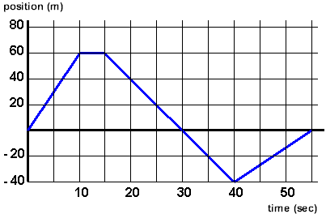
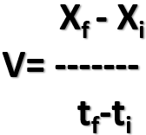
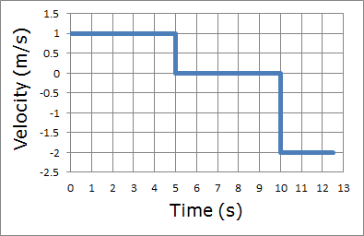
WEEK 10 10/6-10/18
Identify types of motion graphs
Interpret the motion of objects by analyzing motion graphs
Calculate quantities of velocity or displacement using motion graphs
V_{f} - V_{i}
a= -------
t_{f}-t_{i}

Slide 7
TODAY’S STANDARD!
SP1. Obtain, evaluate, and communicate information about the relationship between distance, displacement, speed, velocity, and acceleration as functions of time.
A. Plan an investigation to apply one-dimensional kinematic equations to situations with no acceleration, and positive, or negative constant acceleration

Slide 8
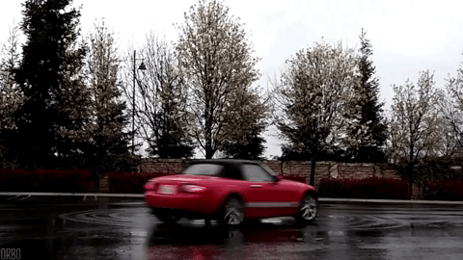
What you should be able to do TODAY!
Solve for quantities of velocity, position, and time when acceleration is constant.
ΔX= V_{i}t + ½at²
V_{f}= V_{i} + at
V_{f}²= V_{i}² + 2aΔx
ΔX = ½(V_{i} + V_{f}) t

Slide 9
BEFORE WE START YOU NEED:
A calculator (phone or TI)
To focus
To pay attention
To be engaged
A little difficult
ΔX= V_{i}t + ½at²
V_{f}= V_{i} + at
V_{f}²= V_{i}² + 2aΔx
ΔX = ½(V_{i} + V_{f}) t

Slide 10
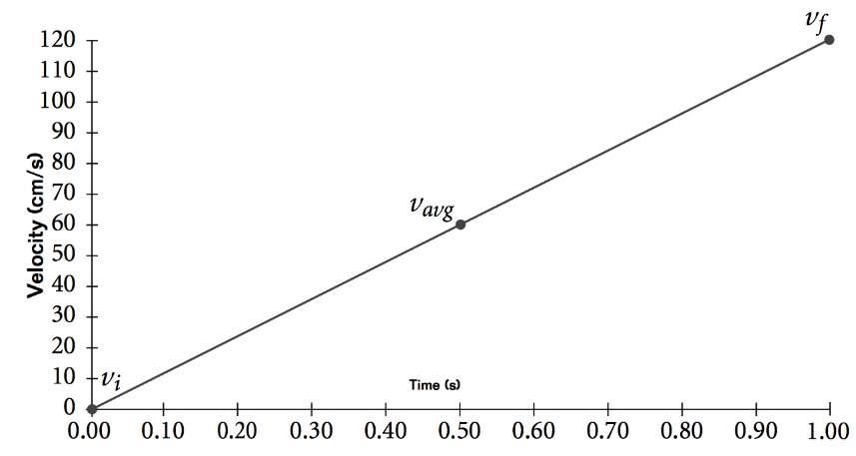
What did we say about this graph in today’s Do-Now??????????????????????

Slide 11
This object is speeding up by the same amount EACH 0.1 second! It’s acceleration is CONSTANT!!

Slide 12
It’s increasing by 100 m/s every 0.1 second!

Slide 13
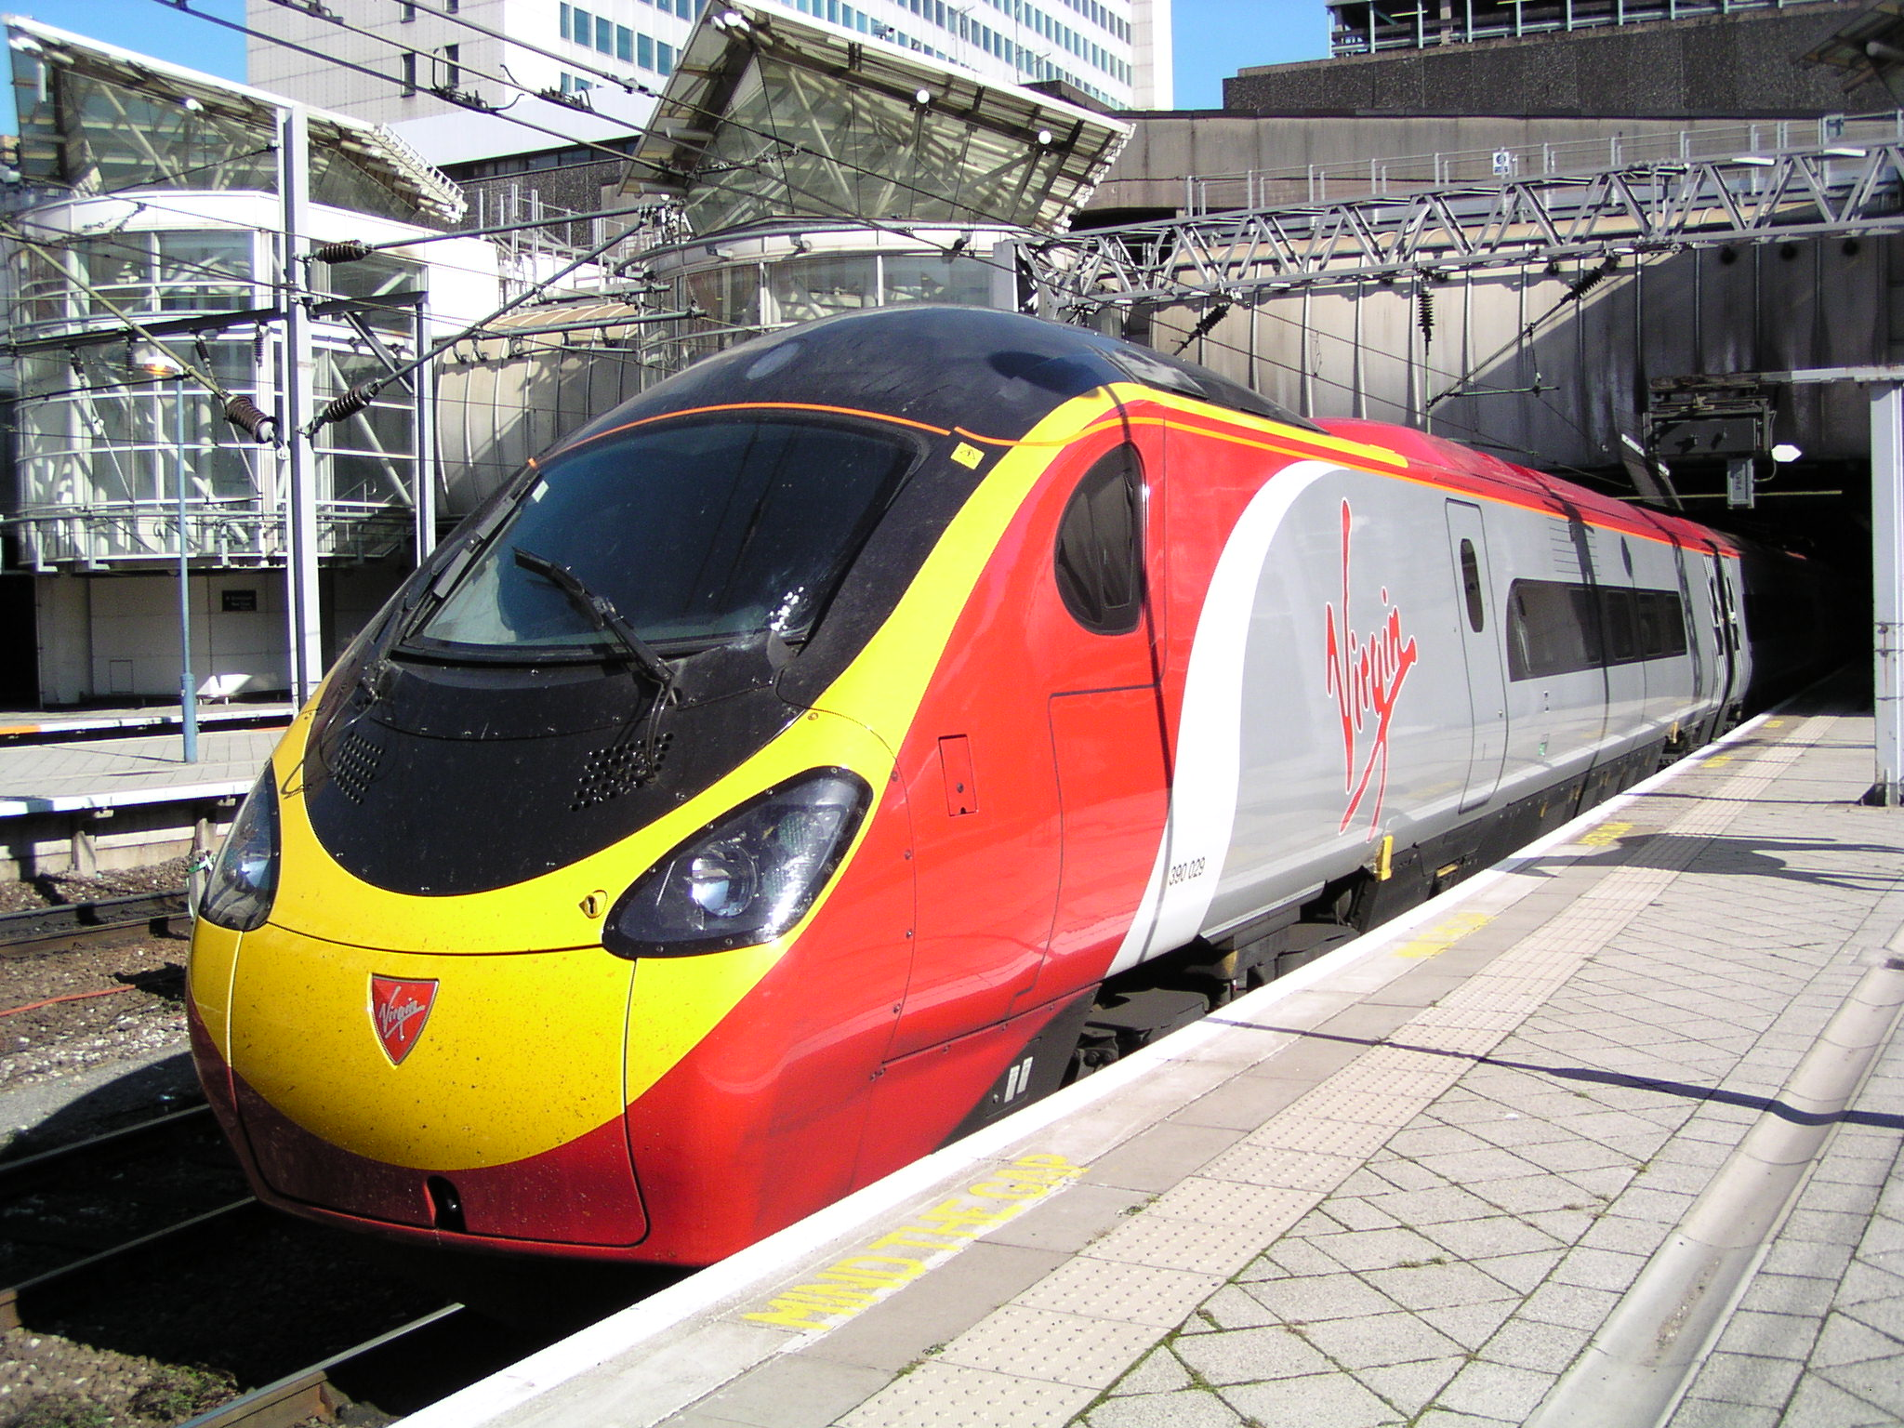
You can figure out WHERE something is, how FAST or SLOW it was going, and how LONG it took for it to do either of the previous variables IF and only IF the acceleration is constant

Slide 14
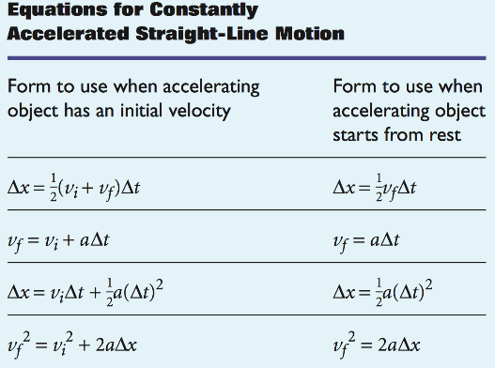
The Kinematic Equations
Kinematic Equations are the algebraic expressions used to predict unknown information about an object’s motion.
They can ONLY be used when the acceleration of an object is constant

Slide 15
KINEMATIC EQUATIONS!!!!
ΔX= V_{i}t + ½at²
V_{f}= V_{i} + at
V_{f}²= V_{i}² + 2aΔx
ΔX = ½(V_{i} + V_{f}) t
Your new best friends!!!

Slide 16
REVIEW (Prior Knowledge)
ΔX=
Vf=
Vi=
a=
Δt=
Displacement (m, km)
Final Velocity (m/s, km/hr)
Initial Velocity ^^^^^^^^^^^^^
Acceleration (m/s²)
Change in time (s, hr, min)
Sometimes V_{i} is written as V_{o}

Slide 17
Solving Problems Using Kinematic Equations
Find What is Given to you in the problem
Find what is Unknown
Determine which Equation should be used, rearrange if needed
Substitute your values into the equations Solve
Don’t guess, USE G.U.E.S.S!

Slide 18
Find What is Given to you in the problem
In 1976, Kitty Hambleton of the United States drove a rocket-engine car to a maximum speed of 965 km/h. Suppose Kitty started at rest and underwent a constant acceleration with a magnitude of 4.0 m/s². What distance would she have had to travel in order to reach the maximum speed?
1) Write the symbols and the values that have been given to you in the problem
You can typically determine by the units or key words
If 3 values are known…YOU CAN FIND THE UNKNOWN!

Slide 19
MODELING-G.U.E.S.S
In 1976, Kitty Hambleton of the United States drove a rocket-engine car to a maximum speed of 965 km/h. Suppose Kitty started at rest and underwent a constant acceleration with a magnitude of 4.0 m/s². What distance would she have had to travel in order to reach the maximum speed?
V_{i}=
V_{f}=
ΔT=
ΔX=
a=
0 km/h
965 km/h
4 m/s²

Slide 20
MODELING-G.U.E.S.S
In 1976, Kitty Hambleton of the United States drove a rocket-engine car to a maximum speed of 965 km/h. Suppose Kitty started at rest and underwent a constant acceleration with a magnitude of 4.0 m/s². What distance would she have had to travel in order to reach the maximum speed?
V_{o}=
V_{f}=
ΔT=
ΔX=
a=
0 km/h
965 km/h
?????
4 m/s²

Slide 21
MODELING-G.U.E.S.S
LABEL the variable that is NOT BEING USED!!!!!!!!
Pick the equation that does NOT have the variable not being used
V_{o}=
V_{f}=
ΔT=
ΔX=
a=
0 km/h
965 km/h
ΔX= V_{i}t + ½at²
V_{f}= V_{i} + at
V_{f}²= V_{i}² + 2aΔx
ΔX = ½(V_{i} + V_{f}) t
NU
?????
4 m/s²

Slide 22
MODELING-G.U.E.S.S
SUBSTITUTE!
Put a number in place of every variable we have!
V_{f}²= V_{i}² + 2aΔx
V_{o}=
V_{f}=
ΔT=
ΔX=
a=
0 km/h
965²= 0² + 2(4)Δx
965 km/h
NU
?????
4 m/s²

Slide 23
MODELING-G.U.E.S.S
SOLVE
Do the CORRECT math
V_{f}²= V_{i}² + 2aΔx
V_{o}=
V_{f}=
ΔT=
ΔX=
a=
0 km/h
965²= 0² + 2(4)Δx
965 km/h
931225= 0 + 8Δx
NU
931225= 8Δx
?????
=116,403.12
km
8 = 8
4 m/s²

Slide 24
ONE BIG MISTAKE!!!!
There are ALWAYS THREE NUMBERS GIVEN!!!!!!!!!!!!!!!!!!!!!!!!
-USE CONTEXT CLUES!!!!!!!
-It’s typically something about “rest” …..”stopped”

Slide 25
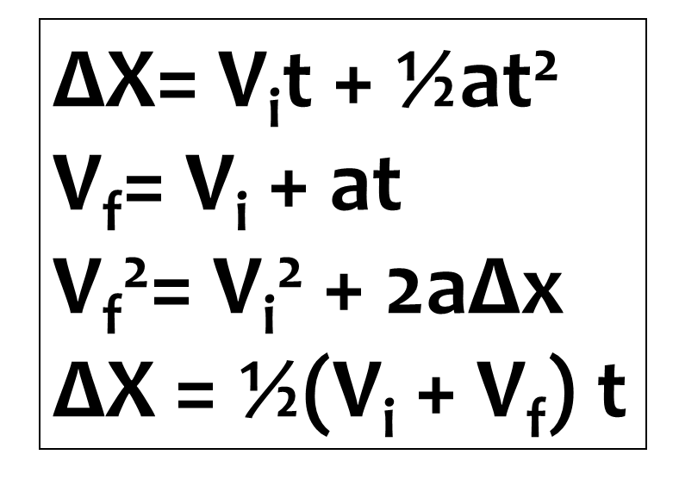
2. A car starts from rest and accelerates uniformly to reach a speed of 23 m/s in 5.5 s. What was the speed of the object after 4.0 seconds?
V_{f}= V_{i} + at
V_{i} =
V_{f}=
t=
ΔX=
a=
0 m/s
23= 0 + a(5.5)
23 m/s
5.5s
23= a(5.5)
5.5= (5.5)
V_{f}= V_{i} + at
??
V_{f}= 0 + (4.18)(4)
a=4.18m/s²
V_{f}= 16.72m/s

Slide 26
Guzman throws Derrick a baseball. The baseball is approaching him at a velocity of 60m/s and it hits the ground 125m away at a velocity of 87m/s, what was the acceleration of the baseball?
V_{i} =
V_{f}=
t=
ΔX=
a=
60 m/s
ΔX= V_{i}t + ½at²
V_{f}= V_{i} + at
V_{f}²= V_{i}² + 2aΔx
ΔX = ½(V_{i} + V_{f}) t
87 m/s
NU
125 m
???

Slide 27
Guzman throws Derrick a baseball. The baseball is approaching him at a velocity of 60m/s and it hits the ground 125m away at a velocity of 87m/s, what was the acceleration of the baseball?
V_{f}²= V_{i}² + 2aΔx
V_{i} =
V_{f}=
t=
ΔX=
a=
60 m/s
87²= 60² + 2a(125)
87 m/s
7569= 3600 + 250a
NU
-3600
-3600
a= 15.88
3969= 250a
m/s²
125 m
250
250
???

Slide 28
Jared is walking down the 100 m long red hall at about 1.2m/s. About halfway down the hall the late bell rings and he speeds up to 2.1 m/s. How long did it take him to do this?
V_{i} =
V_{f}=
t=
ΔX=
a=
1.2 m/s
ΔX= V_{i}t + ½at²
V_{f}= V_{i} + at
V_{f}²= V_{i}² + 2aΔx
ΔX = ½(V_{i} + V_{f}) t
2.1 m/s
???
50 m
NU

Slide 29
Jared is walking down the 100 m long red hall at about 1.2m/s. About halfway down the hall the late bell rings and he speeds up to 2.1 m/s. How long did it take him to do this?
V_{i} =
V_{f}=
t=
ΔX=
a=
1.2 m/s
ΔX = ½(V_{i} + V_{f}) t
2.1 m/s
50 = ½(1.2 + 2.1) t
50 = ½(3.3) t
???
50 = 1.65t
50 m
s
t=30.30
1.65 =1.65
NU

Slide 30
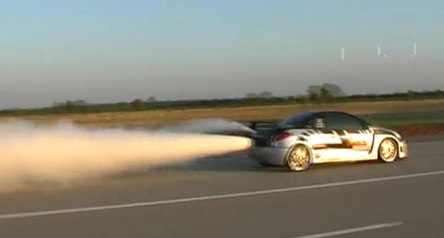
EXIT TICKET
The fastest speeds traveled on land have been achieved by rocket powered cars. Suppose that a car starts from rest and reaches a velocity of 1090 km/h in a distance of 20.0km. How long does it take to make the drive?
What is the initial velocity?
Identify the other two values given in this problem
What are we solving for in this problem?
Which variable is not being used?
Which equation should we pick to solve this equation?
Solve for the missing variable
V_{i}=
V_{f}=
t=
ΔX=
a=
ΔX= V_{i}t + ½at²
V_{f}= V_{i} + at
V_{f}²= V_{i}² + 2aΔx
ΔX = ½(V_{i} + V_{f}) t

